Slide 1
Putting the power of language
to work for your business
Jane Q. Interpreter
Your Company Name / Title
Notes:
The slides and notes in this presentation are suggestions to help you get you started when presenting to potential clients. Personalize this presentation by incorporating your own experiences and examples. The presentation will be more effective if you also adapt it to fit the needs of your own potential clients.
Title slide
Craft a title to fit your specific audience. Here are some examples of how you could personalize this slide:
- Putting the power of language to work for small businesses in [name of your city]
- Putting the power of language to work in international business
- Putting the power of language to work in community healthcare
Sample statements for your introduction
I’m a professional interpreter, which means I help people communicate across different languages and cultures. Interpreters serve as the voice of their clients in virtually every sector of the economy. Today, I’d like to share with you about how interpreters facilitate business, and how I can make your business more successful.

Slide 2
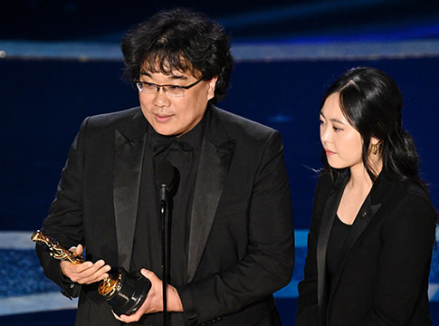
Notes:
Start with a humorous or memorable “hook” to quickly illustrate the impact of professional interpreting.
Sample statements
You may remember the 2020 Oscars, when the director of the film “Parasite” spoke through an interpreter when he took the stage for multiple awards. His acceptance speeches were funny and poignant, and the seemingly effortless work of his interpreter allowed us to instantly understand his personality and wit.
When the spoken word is transmitted by a professional interpreter, communication is seamless and language barriers vanish.

Slide 3
Q Why use an interpreter?
A Because reaching out to people
in their own language draws them in and makes it easier to work with (and sell to) them.
Notes:
Sample statements
So… why use an interpreter?
Because not everybody speaks your language… far from it! In 2020, the top ten languages in use on the Internet are Chinese, Spanish, Arabic, Portuguese, Indonesian, French, Japanese, Russian, German, and of course, English (source: https://www.internetworldstats.com/stats7.htm).
2. Because accurate communication with your audience reduces risks, prevents embarrassment, and can boost sales. In the Graziadio Business Review, Dr. Jennifer Roney wrote, “The choice of an interpreter may be one of the most important choices you make when conducting business globally.” (source: https://gbr.pepperdine.edu/2010/08/language-culture-and-global-business/)

Slide 4
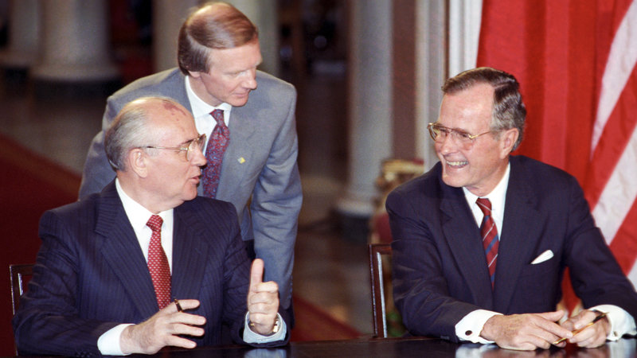
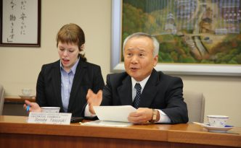
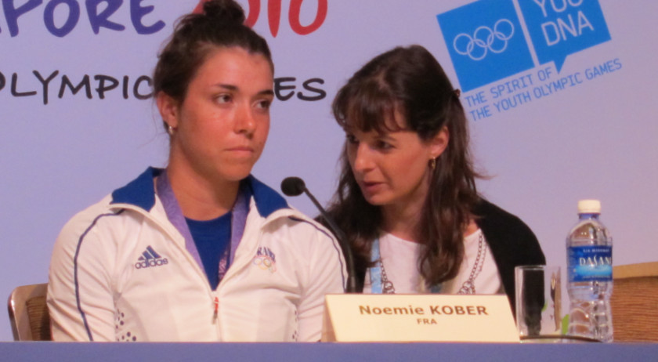
Notes:
EXAMPLES:
Professional interpreters work in a variety of high-stakes and internationally-visible situations, where accurate and culturally-appropriate communication is crucial, like we see in the images here. These are examples of international events in the realm of diplomacy, politics, business and sports.

Slide 5
Q Why use a professional
interpreter?
A Because in many settings you are legally obligated to hire a qualified professional.
Notes:
It takes more than just the ability to speak two languages to be an interpreter. Professional interpreters have the education, experience and expertise to understand the nuances in one language and transfer them to another. The right interpreter for your event will also have solid knowledge of your industry and experience interpreting the type of event you will be conducting. In addition, a professional interpreter will know how to culturally adapt your content to the target audience you are trying to reach at your event. It is true that you only get one chance to make a first impression, so make sure it counts.

Slide 6
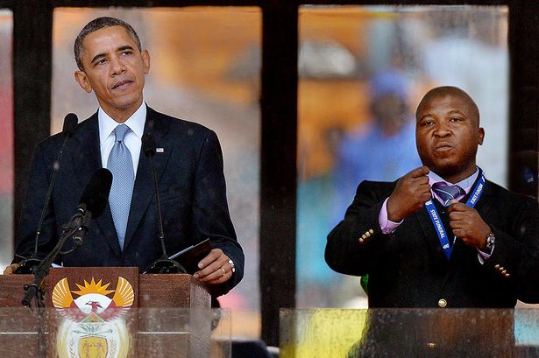
Notes:
EXAMPLE
Failure to use a professional interpreter can reflect negatively on the message itself, or even become the news altogether. This image is from the Nelson Mandela memorial service, where the interpreter we see on the right was called a ‘fake’ sign language interpreter. Most of us probably learned about it after the event, but just imagine being an audience member relying on the interpreter for full participation in the service. Without a professional interpreter, your message—and your audience—can be lost.

Slide 7
If you are relying on limited language skills to communicate, important pieces of information can be lost and trust can suffer irreparable harm.
Notes:
This statement highlights a problem specific to interpretation:
If your own language skills are limited, or you are relying upon an interpreter who has limited language skills, your listener may miss important information and never even ask for clarification out of politeness or other social norms. They can also lose trust in you and become hesitant to do business with you in the future.
This is yet another reason why you should use a qualified interpreter for your communication needs: someone you can trust (and who has their own reputation to look out for).
A professional, recognized interpreter who knows how to ensure your message is conveyed as you intended and that communication is seamless overall.

Slide 8
Here are four simple tips to help you ensure high-quality communication while minimizing cost and stress:
1. Plan ahead
2. Hire a professional
3. Spend wisely
4. Listen to your
interpreter
Notes:
Today I want to give you some practical advice about how to ensure high-quality communication while minimizing cost and stress.
An ATA brochure called “Interpreting, getting it right” lays out the basics.
OPTIONS:
[You’ve got a copy in your bag]
[There are copies on the table at the back]
and you can download a pdf at no charge from the ATA site (atanet.org).
I’ve got four tips to share with you today…
READ THE SLIDE OUT LOUD.
THEN CONTINUE:
Virtually any profession (accountants, lawyers, architects, etc.) would give you pretty much the same advice, right?
So in the 15 minutes [OR HOWEVER LONG] we’ve got left, I would like to go into a bit more detail.
NB: HOW MUCH DETAIL WILL DEPEND ON HOW LONG YOUR SPEAKING SLOT IS.
IF SHORT, YOU CAN STICK WITH THE FOUR MAIN POINTS. IN THIS CASE, PRINT THE MORE DETAILED SLIDES OUT AS HANDOUTS, AND SAY:
The handout in your folder/on your chair/at the back of the room lists specific issues you’ll want to look at more carefully.]
IF YOU HAVE MORE TIME, RUN THROUGH THE DETAILED SLIDES WITH YOUR AUDIENCE.

Slide 9
1. Plan ahead to avoid stress and errors—and to save time and money.
Notes:
If you are thinking of expanding abroad or anticipate interpreting needs of any kind in the future, start organizing now.
Planning on your side is important—be sure to think of the details of your event, including location and availability of interpreters.
In addition, as part of your planning:
contact potential providers — not only for a quote (budget), but to make sure there’s a good fit between your way of working and theirs.
make it clear that you are available to provide information and guidance, answer questions in a timely manner, training on your products or services, and any other background information you can share about your event. That you want to be involved and may be able to make adjustments if needed to ensure fluid communication at all points.
SPEAKER: EITHER REFER AUDIENCE TO THE HANDOUT (OF LIST IN FOLLOWING SLIDE) OR, IF YOU HAVE TIME, RUN THROUGH IT:
More specifically…

Slide 10
1. Plan ahead with these questions:
What language(s) do I need to communicate in and how can I find an interpreter?
How will I communicate with my audience?
What technology might I need?
What informal situations are planned?
Do I have written materials that go along with my event, and do they need to be translated?
Notes:
DEVELOP THESE POINTS, ADDING EXAMPLES FROM YOUR OWN PRACTICE.
FOR EXAMPLE:
Before even before seeking the interpreter, you first have to identify the language(s) you require. “Chinese” is not enough – do your clients speak Mandarin, Cantonese or Hakka? If the language is Portuguese, is it the variety spoken in Portugal, Brazil, or another country? Advance notice of accents and dialects will help even the most skilled interpreter ensure smoother communication. You also need to identify where the interpreter will be working, not only the city or country but also the setting. For example, the interpreting modes for a medical conference will be different that what could be needed for a factory tour, and while you are seeking the interpreter this will be helpful information to help your interpreter prepare. You can seek individual interpreters who have the experience and specialization you seek. If your event is lengthy or complex, you may need to seek more than one interpreter, and it is likely that the first interpreter can help you find a trusted colleague to create a team. If you need more languages plus technology like interpreter equipment for a major conference, you may find it simpler to use an agency or an event coordinator.
Think about how you will communicate with your audience – will it be a conference, where you will be in front of the audience for a day, or two, or more? These things will help you work through how many interpreters you will need for the event and whether you will need to plan for interpreter travel.
You should also think about the technology you may need for interpreter participation – whether they will assist remotely or in person, some sort of technology needs are likely and should be planned in advance (perhaps with the assistance of the interpreter(s) or agency).
Also think about what sort of informal communication situations are planned – after-hours events like dinners, tours of the local area, etc.
Finally, think about the sort of written materials you will provide as part of your event (do you need to have them translated?) See ATA’s brochure Translation: Getting it Right for guidance
HAVE THE TRANSLATION-GETTING IT RIGHT BROCHURES AVAILABLE

Slide 11
2. Hire an experienced professional.
Being bilingual is not enough.
Notes:
My second tip:
If you speak only one language yourself, it’s easy to think that someone on your team who seems to speak a foreign language is fluent or even bilingual.
But experience shows that many of these people are simply not up to the task. For one thing, speaking your own words isn’t the same as transmitting the words of another, let alone when the pressure is on.
Remember: professional interpreters are highly skilled in getting messages across using a variety of techniques that take time to master. They are also trained to avoid taking sides, so as to avoid skewing the exchange of information.

Slide 12
What you should be looking for:
Experience
Fluency in working languages
Periods of residence abroad
Certification, when applicable, or verified credentials
Specialized training and continuing education
Membership in professional associations
Notes:
DEVELOP THESE POINTS, ADDING EXAMPLES FROM YOUR OWN PRACTICE.
FOR EXAMPLE:
Nothing against beginners, but interpreting is like in any profession: the more experience your provider has, the better their work will be. To find a good match for your event, ask potential providers about their experience with the subject matter and event type that you are planning. See if they can provide samples of their work (audio/video) or references that you can contact in advance.
Does your interpreter possess advanced knowledge of the languages they will use for your event? A broad vocabulary and near-native/native fluency in their working languages are essential to their ability to transmit your messages. Their demonstrable experience or education can be helpful in determining their likely fluency.
Has your interpreter spent time in a country where their non-native language is spoken? This can give them insight into language, culture, and more.
Professional interpreters take their work seriously, and their expectations about working conditions will ensure they can adhere to standards about quality for the type of event (such as their use of technology, advance information to get ready for the event, and the need for team members)
It is also smart to hire someone who is a member of a professional association (like ATA) (and/or who is a credentialed interpreter. If your event involves a highly specialized area, you may want to seek an interpreter who has other qualifications specific to that area. [SPEAKER CAN COMMENT ON HIS/HER QUALIFICATIONS AND SPECIALTIES HERE: CPA, law degree, various certificates, etc.]

Slide 13
3. Spend wisely and be realistic about your budget.
Quality professional interpreting and advance planning save you money in the long run.
Notes:
As they say: “Pay peanuts and you’ll get monkeys”.
There are ways you can reduce your budget safely — often by forward planning and deciding exactly how you want the communication at your event to go.
We recommend using “Interpreting, Getting it Right” as a resource and factoring interpreting (and even written translation) into your project from the beginning. (A separate resource called “Translation, Getting it Right” is available for ensuring your written materials are professionally translated, which can further serve as a supplemental resource for your interpreter)
Paying for the cost of professional interpreting services saves time, money, reputation and the cost of having to engage in clarification conversations or corrective measures down the road. It helps solidify your reputation in any language.

Slide 14
Things to think about:
Do all expected interactions require an interpreter?
What is a reasonable budget?
Higher fees for last-minute plans.
Expect higher costs for highly specialized subject areas and languages of lesser diffusion.
Notes:
DEVELOP POINTS BELOW, ADDING EXAMPLES FROM YOUR OWN PRACTICE
1. Are there informal events planned where you and your client communicate in a shared language with sufficient fluency for the situation? For example, you may not need an interpreter for a dinner event where the conversation is casual and direct communication will not only be preferred but even a great way to connect with your client outside of the business setting.
How much did you spend to develop your plans and materials for your event? If you spent months/years/$$$ on it, skimping on the interpreting service at the last stage of the process is not a good idea. (Far better to accept that you are not ready for the international market).
In fact, if price is your only criterion, don’t be surprised if result doesn’t make the grade. Some suppliers offer unbelievable terms for their service; the results they provide are equally unreal!
If you don’t plan ahead, expect to pay higher fees (solution: plan ahead)
This is only normal: law of supply & demand

Slide 15
Listen to your interpreter.
Expect questions and be ready to answer them. A good interpreter asks questions to understand your needs and your event.
If the event will include written materials, let your interpreter review them before they are finalized.
Your interpreter can provide cultural insight to help facilitate communication. Share event plans.
Notes:
Your interpreter is a key ally to making your event a success. Professional interpreters are passionate about language, cultural and communication. They know a lot about the process and bring to your event all of the expertise they have built up over their career to date. They will want to understand your needs and your event, so expect to answer questions. They will also benefit from reviewing written materials for your event (and they could help you identify issues with the materials that can be rectified before you go to print – share early!) Your interpreter can also provide cultural insight that will help you facilitate communication and plan your event. Again, share early for the best results!
So when you use a professional interpreter’s services, you are not simply buying words, you are harnessing that expertise — the power of language — to ensure that you can focus on getting the deal done — and on doing what you do best.
OVER TO YOU! DEVELOP THESE POINTS, ADDING EXAMPLES FROM YOUR OWN PRACTICE.

Slide 16
With a professional interpreter, you are not just buying words. You are harnessing expertise—the power of language—to communicate the right message, in any language. Hiring a professional interpreter allows you to focus on your own business.
Notes:
BIG CLOSE:
REPEAT THE CORE MESSAGE AND OFFER TO ANSWER ANY QUESTIONS YOUR AUDIENCE MIGHT HAVE.

