Slide 1
Putting the power of language
to work for your business
Jane Q. Translator
Your Company Name / Title
Notes:
The slides and notes in this presentation are suggestions to help you get you started. You should personalize this presentation by incorporating your experiences and examples. The presentation will be more effective if you also adapt it to fit the needs of your potential clients.
Title slide
Craft a title to fit your specific audience. Here are some examples of how you could personalize this slide.
- Putting the power of language to work for small businesses in [name of your city]
- Putting the power of language to work in patent litigation
- Putting the power of language to work in community healthcare
Sample statements for your introduction
I’m a professional translator, which is one of the most exciting jobs around. Translators often work in the shadows, but the work we do sets the stage for transactions in virtually every sector of the economy. Today I want to tell you about how I work, and how I can make your business more successful.

Slide 2
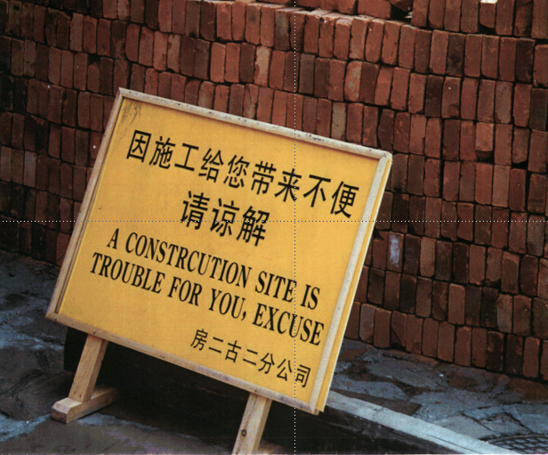
Notes:
Start with a humorous “hook” to quickly illustrate a problem.
Sample statements
Funny, right?
This sign makes us laugh because we all know what this construction company was trying to say.
When a text is translated by a professional translator, readers usually don’t even know it is a translation.
Language is no longer a barrier or source of embarrassment. It’s a bridge.

Slide 3
Q Why translate?
A Because reaching out to people
in their own language draws them in and makes it easier to work with (and sell to) them.
Notes:
Sample statements
So… why translate?
1. Because not everybody speaks your language… far from it!
2. Because translating for your target audience reduces risks, prevents embarrassment, and boosts your sales.

Slide 4
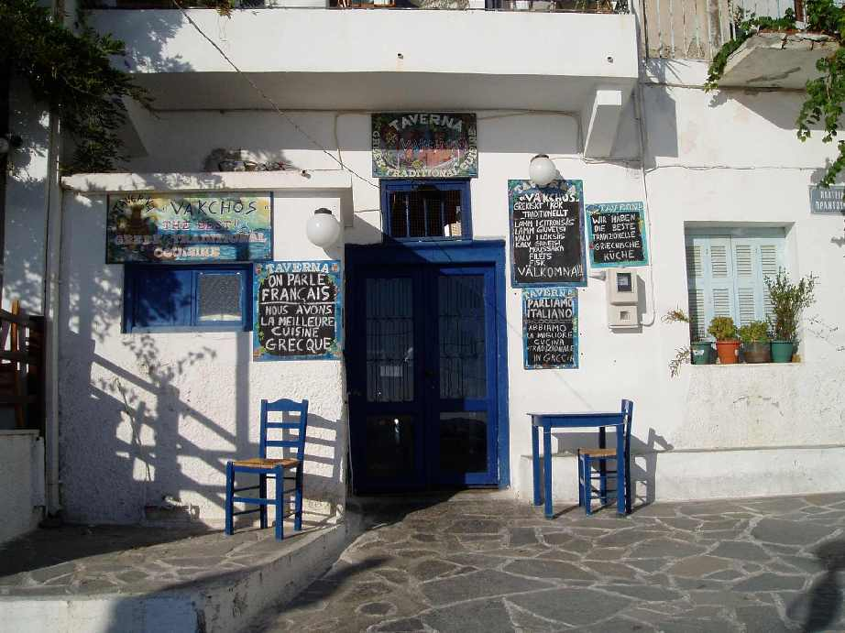
Notes:
EXAMPLE: TRANSLATIONS MAKE PEOPLE FEEL WELCOME!
Take this little taverna in Greece. It’s a mom and pop shop, doing its best to draw in passing trade. Notice the blackboard messages in French, German, English, and Swedish. [ZOOM IN]
If you are like most potential customers, you’ll be more tempted to enter a restaurant (or use a business) that speaks your language.
This restaurant seems friendlier and focused on your
They seem friendlier they’ll try to make you feel at home.
The same is true in technology-driven areas: research shows that websites attract more visitors and keep them much longer if your site is in their language.
But there are two more reasons why it pays to translate documents for your target audience:
• Because when the texts you publish do their job, you are free to do yours. You can get on with your real business, and not worry about looking like an idiot or saying something you didn’t mean to.
• Because in some countries and regions, translation is required by law.
[GIVE A SPECIFIC EXAMPLE THAT THE AUDIENCE CAN RELATE TO, E.G., TRANSLATION REQUIREMENT FOR HEALTHCARE FACILITIES GETTING FEDERAL FUNDS, LOI TOUBON IN FRANCE, ETC.]

Slide 5
Q Why use a professional
translator?
A Because translation errors can
be costly, even disastrous. You
can’t risk getting it wrong.

Slide 6
Notes:
Crédit Agricole is one of the biggest banks in Europe, yet they stumbled when they chose this phrase for the front cover of their annual report. The French person (who speaks English) didn’t “get” that, in English, “under scrutiny” implies that the company is under investigation or review.
Reprinting this report cost Crédit Agricole a bundle.
And you can imagine the image problem. In this internet era, an unfortunate translation cannot be pulled back in; the electronic version lives on.

Slide 7
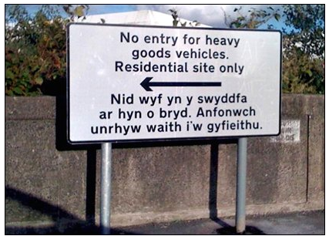
Notes:
Here’s another example: Swansea is a town in northern Wales, in Britain.
Recently the Swansea town board put up a new sign to redirect truck traffic away from a housing development. This is what it looked like.
Both English and Welsh are spoken in Wales, which means signs are in both languages (that is required by law).
Problem: the Welsh reads “I am not in the office at the moment. Send any work to be translated.”
[EXPLANATION: the department responsible for producing the signs didn’t have a Welsh speaker in-house. So they simply assumed the message they received back from the translator was a translation of their sign].
Budget + image: both took a hit.
(Making and installing signs is expensive).

Slide 8
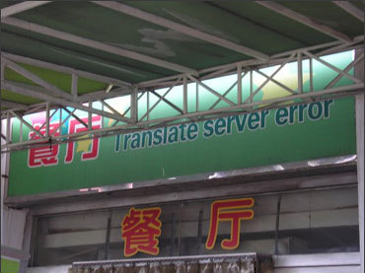
Notes:
In Beijing, a restaurant wanted to attract international visitors during the Olympic games. Instead of hiring a professional translator, they used a computer program. The result speaks for itself.

Slide 9
If you are buying a text translated
into a language you don’t understand, you have no way of judging what you get.
Notes:
This highlights a problem specific to translation:
if you are buying a text translated into a foreign language, you have no way of judging what you get.
Which means you must deal with a qualified supplier, somebody you can trust (and who has their own reputation to look out for).
A professional!

Slide 10
Here are four simple tips to help you get the translation you need and keep your costs and stress to a minimum:
1. Plan ahead
2. Hire a professional
3. Spend wisely
4. Listen to your
translator
Notes:
Today I want to give you some practical advice about how to avoid embarrassing mistakes.
About how to get texts translated right the first time around.
An ATA brochure called “Translation, getting it right” lays out the basics.
OPTIONS:
[You’ve got a copy in your bag]
[There are copies on the table at the back]
and you can download a pdf at no charge from the ATA site (atanet.org).
The ATA also publishes a more detailed explanation of the types of questions you’ll need to answer right up front to make sure your budget is spent well.
It’s called “Translation: Buying a non-commodity” and is also downloadable for free in pdf format from the ATA website.
But I’ve got four tips to share with you today…
OK, THIS TIME, READ THE SLIDE OUT LOUD.
THEN CONTINUE:
But virtually any profession (accountants, lawyers, architects, etc.) would give you pretty much the same advice, right?
So in the 15 minutes [OR HOWEVER LONG] we’ve got left, I want to go into a little more detail.
NB: HOW MUCH DETAIL WILL DEPEND ON HOW LONG YOUR SPEAKING SLOT IS.
IF SHORT, YOU CAN STICK WITH THE FOUR MAIN POINTS. IN THIS CASE, PRINT THE MORE DETAILED SLIDES OUT AS HANDOUTS, AND SAY:
The handout in your folder/on your chair/at the back of the room lists specific issues you’ll want to look at more carefully.]
IF YOU HAVE MORE TIME, RUN THROUGH THE DETAILED SLIDES WITH YOUR AUDIENCE.

Slide 11
1. Plan ahead to avoid stress and disaster—and to save time and money.
Notes:
If you are thinking of expanding abroad or see translating needs of any kind in the future, start organizing now.
Concretely,
contact potential providers — not only for a quote (budget), but to make sure there’s a good fit between your way of working and theirs.
make it clear that you are available to provide information, answer questions, etc. That you want to be involved.
SPEAKER: EITHER REFER AUDIENCE TO THE HANDOUT (OF LIST IN FOLLOWING SLIDE) OR, IF YOU HAVE TIME, RUN THROUGH IT:
More specifically…

Slide 12
Plan ahead with these questions:
Do you need a translator (written) or an interpreter (spoken)?
What precisely will your text be used for?
Which language(s) are you translating from and into?
What is your deadline? When will the original text be finalized and ready to translate?
What format will the text be in?
Notes:
DEVELOP THESE POINTS, ADDING EXAMPLES FROM YOUR OWN PRACTICE.
FOR EXAMPLE:
Interpreters speak (booth, etc.) and translators write (texts).
2. If all you need is a draft, say so; if your text is advertising copy that will go on 8700 bus shelters city-wide, say so. If your text is a speech that must be delivered by somebody who doesn’t speak the language that well, say so. If it is press release subject to legal provisions, say so.
This is more complex than you might think SPEAKER: GIVE AN EXAMPLE FROM YOUR OWN PRACTICE, E.G.
Portuguese is spoken in Brazil and Portugal (and Angola and Cape Verde and other places, too). Which market are you interested in?
French is spoken in Canada, France, Belgium, Luxembourg, Switzerland, some African countries and many many many other places; Spanish: same thing. There are lots of regional variations.
4. Translators are writers; for texts where style counts, 1500-2000 words a day is generally considered normal. Drafts and “bulk work” are different. But if you force writers to churn it out, your text will read… churned out. And always (always always) build in time for the translator to proofread your laid-out text *before* printing.
5. Can the text be in Word, or will it be reformatted for a website, or for a PowerPoint presentation, or… ?

Slide 13
2. Hire an experienced professional.
Being bilingual is not enough.
Notes:
My second tip:
If you speak only one language yourself, it’s easy to think that someone on your team who seems to speak a foreign language is fluent or even bilingual.
But experience shows that many of these people are simply not up to the task. For one thing, speaking isn’t the same as writing. And even if they do speak a language, they are not necessarily good at writing it, or (and this is just as important) actually moving from one language to another.
Remember: professional translators — even professionals! — work only into their native language.
THIS IS IMPORTANT:
Regardless of vendors’ claims, computer software programs that translate are not ready for prime time.
If you do use one, use it only for “inbound” translation -- to find out what the other guys are doing (sort of).
Under no circumstances use computer translation for texts that will be sent out, unchecked, to your foreign clients.
You will lose face, and may well offend.

Slide 14
What you should be looking for:
Experience (ask for examples of previous work and run these past your foreign partners)
Periods of residence abroad
Someone who works into his/her native language
Certification, when applicable, or verified credentials
Specialized training and continuing education
Membership of professional associations
Notes:
DEVELOP THESE POINTS, ADDING EXAMPLES FROM YOUR OWN PRACTICE.
FOR EXAMPLE:
Nothing against beginners, but translation is like in any profession: the more experience your provider has, the better their work will be in general.
To find a good match for your project, ask potential suppliers for examples of their work: texts that they have translated and that they are particularly happy with. Show these to your own business contacts who are natives of the countries where you plan to use the text; get their opinion.
Has your translator spent time in the country where the language they translate is spoken? That can give them insights into language, culture, and more.
Very important: translators work into their native language only.
[GIVE AN EXAMPLE FROM YOUR OWN PRACTICE, E.G.] : So, for example, my language combination is Spanish into English; I can translate your Colombian subsidiary’s reports into English for you, but if you want minutes of your board meeting into Spanish for them, you’ll need someone else.
5. See our brochure “Translating — Buying a non-commodity” [in your bag/folder]/[at the back of the room]/[downloadable from the ATA website] to get some very concrete advice on how the recently adopted US and European standards on translation services can help you get what you need.
4. You’ll never have a totally bulletproof guarantee, but someone who is a member of a professional association (like ATA) (/has a credential in translation — not teaching, etc.) is a better bet. If your translation is in a highly specialized area, your translator may well have a second credential, too. [SPEAKER CAN COMMENT ON HIS/HER QUALIFICATIONS AND SPECIALTIES HERE]

Slide 15
3. Spend wisely and be realistic about your budget.
Quality professional translation doesn’t come cheap, but you can save money by thinking about your needs.
Notes:
As they say: “Pay peanuts and you’ll get monkeys”.
But there are also ways you can reduce your budget safely — often by forward planning and deciding exactly what you want your text to do.
We recommend using “Translation, Getting it right” as a resource and factoring translation/interpreting into your project from the beginning.

Slide 16
Things to think about:
Does it all need to be translated?
What is a reasonable budget?
Rush fees.
Expect higher costs for published materials, highly specialized subject areas and languages of limited diffusion.
Notes:
DEVELOP POINTS BELOW, ADDING EXAMPLES FROM YOUR OWN PRACTICE
1. Don’t translate everything blindly: review your document first (perhaps with your translator) to make sure that the information in it is something that foreign buyers can relate to. Example: a financial translator reduced a 500-page document to less than half that by eliminating repetitions and sections that the target readers didn’t need to know.
2. How much did you spend to develop your new project? If you spent months/years/$$$ on it, skimping on the translation of promotional documents is a bad idea. (Far better to accept that you are not ready for the international market).
In fact, if price is your only criterion, don’t be surprised if the job delivered doesn’t make the grade. Some online suppliers offer unbelievable turnarounds; the results are equally unreal!
If your translator has immediate availability, a birth certificate or diploma might be ready the next day and cost less than $100; a top-quality annual report can take weeks and run into thousands of dollars.
If you don’t plan ahead, expect to pay rush fees (solution: plan ahead)
This is only normal: law of supply & demand

Slide 17
Listen to your translator.
Expect questions and be ready to answer them. A good translator asks questions to understand your needs and your text.
If the text will be reformatted in any way, have your translator take a final look before printing.
If your translation is going into a language you cannot read, have other professionals review the translation.
Notes:
Professional translators spend 8 to 15 hours a day grappling with texts.
Good ones are passionate about language.
They know a lot, and they bring to your project all of the expertise they have built up over their career to date.
So when you use a professional translator’s services, you are not simply buying words, you are harnessing that expertise — the power of language — to ensure that you can focus on getting the deal done — and on doing what you do best.
OVER TO YOU! DEVELOP THESE POINTS, ADDING EXAMPLES FROM YOUR OWN PRACTICE.

Slide 18
With a professional translator, you are not just buying words. You are harnessing expertise—the power of language—to get your text right. Hiring a professional allows you to focus on your business.
Notes:
BIG CLOSE:
REPEAT THE CORE MESSAGE AND OFFER TO ANSWER ANY QUESTIONS YOUR AUDIENCE MIGHT HAVE.

