Slide 1
Introduction to
Translation and Interpreting

Slide 2
About me
What is the
[Translator/Interpreter]
[Languages]
[Specializations]
[Training/Education]
[Fun facts/favorite part of your career]
Notes:
Personalize this slide by adding your details in between the red brackets, and then deleting the brackets.

Slide 3
About the American Translators Association (ATA)
What is the
National not-for-profit association with an international orientation
Largest professional association of language professionals in the United States
Notes:
ABOUT ATA

Slide 4
A Day in the Life…
Mission Statement
Notes:
A Day in the Life of Translators and Interpreters
ATA invites you to see how translators and interpreters work in this short, animated video!
If you have internet access, you can play this embedded video. You can also view this video using this link: https://www.atanet.org/video/a-day-in-the-life-of-translators-and-interpreters/
If you do not have internet access, you can download this video to play during your presentation using this link: https://vimeo.com/americantranslators/download/418207914/703357f815

Slide 5
Can you tell me…
What’s the difference between a translator and an interpreter?

Slide 6
What is the difference between translators and interpreters?

Slide 7
Translators work from their second language into their native language.
For example, I’m [an X to Y translator].
What language would you translate into?
Notes:
Personalize this slide by adding your details in between the red brackets, and then deleting the brackets.

Slide 8
Interpreters work in both directions.
For example, I interpret between [X and Y].
What languages would you interpret?
Notes:
Personalize this slide by adding your details in between the red brackets, and then deleting the brackets.

Slide 9
Have you ever…
Worked with or seen an interpreter before? (At the doctor’s office, in movies)
Read something that was translated before? (a book, subtitles on a film)

Slide 10
Did you know…
Before you become a translator or interpreter:
You must be bilingual.
That means you need to speak, read, and write almost perfectly in more than one language.
Being bilingual isn’t enough.
Additional training is needed to become a professional interpreter or translator.

Slide 11
Training opportunities
ATA’s list of programs:
www.atanet.org/career-education/student-resources/translation-interpreting-courses
GALA Academic Member Directory:
www.gala-global.org/membership/ member-directories/academic-member-directory

Slide 12
Did you know…
Translators and interpreters specialize in a field they like or know a lot about.
For example, [I’m an X-to-Y translator, and I specialize in Z. I translate things like A, B and C].
Notes:
Personalize this slide by adding your details in between the red brackets, and then deleting the brackets. Further personalize by adding a photo that represents your specialization.

Slide 13
Common areas of work for translators and interpreters

Slide 14
Translation problems…
What happens if you work with an unprofessional translator or interpreter?
Some translation mistakes can be funny, and some can be very serious!

Slide 15
The 71-million-dollar word
In 1980, 18-year-old Willie Ramirez was taken to a hospital. His family tried to describe his condition to the doctors, but they only spoke Spanish.
Interpreting was provided by a bilingual staff member who translated "intoxicado" as "intoxicated." This was incorrect, because intoxicated in English refers to an overdose of drugs or alcohol.

Slide 16
The 71-million-dollar word
Ramirez's family thought he had food poisoning.
His brain was bleeding, but the doctors treated him as if he had taken too many drugs.
Because of the delay in treatment, Ramirez was left quadriplegic. He received a malpractice settlement of $71 million.
If the hospital would have hired a professional interpreter, this could have been prevented.

Slide 17
Where do translators and interpreters work?
Freelancer: Many run their own business from home and work for agencies or direct clients.
Private sector: International companies, law firms, hospitals
Public sector: Government, politics, legal system, military, law enforcement (CIA, FBI)
Agencies: Intermediaries between direct clients and professional freelance translators and interpreters

Slide 18
Can you make a career out of translation and interpreting?

Slide 19
Resources for students
Visit the ATA website for more information: www.atanet.org
Contact your local ATA chapter or affiliate: www.atanet.org/member-center/groups

Slide 20
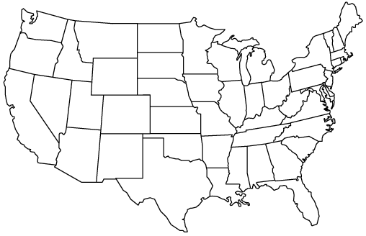
ATA Chapters and Affiliates
NOTIS
UMTIA
OSTI
MiTiN
NYCT
NATI
IITA
DVTA
NCTA
NOTA
NCATA
NITA
UTIA
MATI
CTA
MICATA
TAPIT
CATI
ATISDA
NMTIA
AAIT
EPITA
AATIA
HITA
ATIF

Slide 21
Questions?
[Your contact information]
Notes:
Personalize this slide by adding your details in between the red brackets, and then deleting the brackets.

