Slide 1

Introduction to
Translation and Interpreting

Slide 2
About me
What is the
[Translator/Interpreter]
[Languages]
[Specializations]
[Training/Education]
[Fun facts/favorite part of your career]
Notes:
Personalize this slide by adding your details in between the red brackets, and then deleting the brackets.

Slide 3
About the American Translators Association (ATA)
What is the
National not-for-profit association with an international orientation
Largest professional association of
language professionals in the United States
Notes:
ABOUT ATA

Slide 4
About ATA Membership
What is the
ATA provides community and networking opportunities, webinars, an annual conference, a member directory, certification exams, and more.
ATA membership is open to anyone with an interest in translation and interpreting as a profession or as a scholarly pursuit.
Members are located all over the world!
Notes:
ABOUT ATA

Slide 5
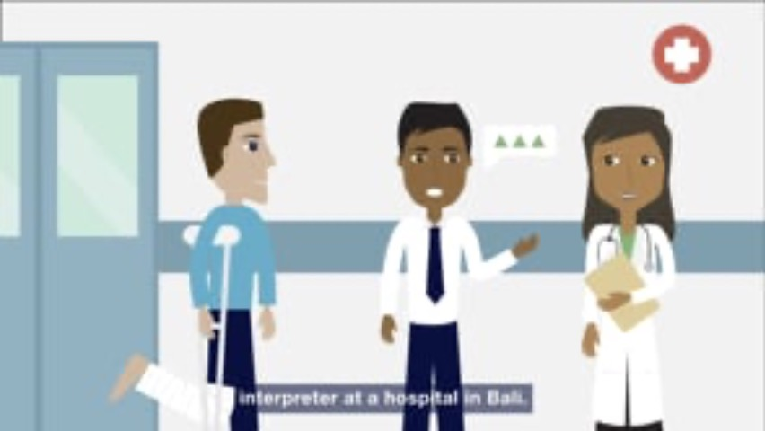
A Day in the Life…
Mission Statement
Notes:
A Day in the Life of Translators and Interpreters
ATA invites you to see how translators and interpreters work in this short, animated video!
If you have internet access, you can play this embedded video. You can also view this video using this link: https://www.atanet.org/video/a-day-in-the-life-of-translators-and-interpreters/
If you do not have internet access, you can download this video to play during your presentation using this link: https://vimeo.com/americantranslators/download/418207914/703357f815

Slide 6
Can you tell me…
What’s the difference between a translator and an interpreter?

Slide 7
What is the difference between translators and interpreters?

Slide 8
Translators work from their second language into their native language.
For example, I’m [an X to Y translator].
What language would you translate into?
Notes:
Personalize this slide by adding your details in between the red brackets, and then deleting the brackets.

Slide 9
Interpreters work in both directions.
For example, I interpret between [X and Y].
What languages would you interpret?
Notes:
Personalize this slide by adding your details in between the red brackets, and then deleting the brackets.

Slide 10

Have you ever…
Worked with or seen an interpreter before? (At the doctor’s office, in movies)
Read something that was
translated before?
(a book, subtitles on a film)

Slide 11
Did you know…
Before you become a translator or interpreter:
You must be bilingual.
  That means you need to speak, read, and write almost perfectly in more than one language.
Being bilingual isn’t enough.
Additional training is needed to become a professional interpreter or translator.

Slide 12
Training opportunities
ATA’s list of programs:
www.atanet.org/career-education/student-resources/translation-interpreting-courses
GALA Academic Member Directory:
www.gala-global.org/membership/ member-directories/academic-member-directory

Slide 13
Training opportunities
Webinars, Workshops, Online Courses
Training from ATA or your local ATA Chapter or Affiliate:
www.atanet.org/career-education
www.atanet.org/ata-events
www.atanet.org/member-center/groups

Slide 14
Top skills needed
Language skills
Subject-matter expertise
Cultural understanding (study abroad, travel)
Writing skills (translator)
Speaking skills and short-term memory (interpreter)
Computer and other technology
Reliable and professional

Slide 15

Specialization
Translators and interpreters specialize in a field they like or know a lot about.
For example, [I’m an X-to-Y translator, and I specialize in Z. I translate things like A, B and C].
Notes:
Personalize this slide by adding your details in between the red brackets, and then deleting the brackets. Further personalize by adding a photo that represents your specialization.

Slide 16



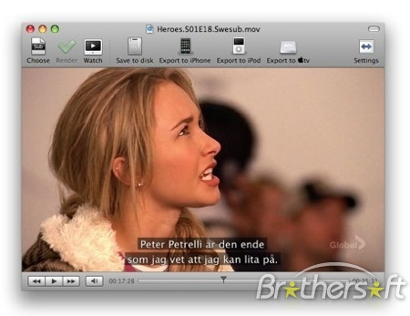


Common areas of work for translators and interpreters

Slide 17
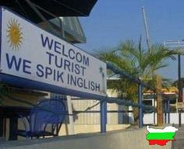
Translation problems…
What happens if you work with an unprofessional translator or interpreter?
Some translation mistakes can be funny, and some can be very serious!

Slide 18
Where do translators and interpreters work?
Freelancer: Many run their own business from home and work for agencies or direct clients.
Private sector: International companies, law firms, hospitals
Public sector: Government, politics, legal system, military, law enforcement (CIA, FBI)
Agencies: Intermediaries between direct clients and professional freelance translators and interpreters

Slide 19
Examples of clients
Individuals
Passports, driver’s licenses, birth certificates
Hospitals and clinics
Courts
International businesses
Think about McDonald’s. With restaurants all over the world, they have to translate all their menus.

Slide 20
Examples of clients
United Nations
The United Nations has 6 official languages and needs translators and interpreters for all of them.
Government
The U.S. Central Intelligence Agency has a team of translators and interpreters that work for them.
The U.S. Armed Forces use interpreters and translators around the world.

Slide 21
Can you make a career out
of translation and interpreting?

Slide 22
The life of a freelancer
Pros: flexible schedule, choose your own work and rates
Cons: managing business and other tasks in addition to translating/interpreting
Discussion: How about you? Do you have what it takes to work as a freelancer?

Slide 23
Resources for students
The Savvy Newcomer:
www.atanet.org/savvynewcomer
Annual Conference:
www.atanet.org/conference
Guide to Starting Out as a Translator: www.atanet.org/career-education/starting-your-career/guide-to-starting-out-as-a-translator/
Certification Exam
www.atanet.org/certification

Slide 24
Resources for students
Visit the ATA website for more information: www.atanet.org
Contact your local ATA chapter or affiliate: www.atanet.org/member-center/groups

Slide 25
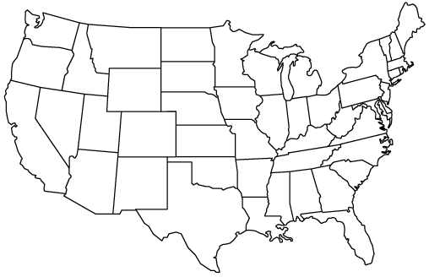
ATA Chapters and Affiliates
NOTIS
UMTIA
OSTI
MiTiN
NYCT
NATI
IITA
DVTA
NCTA
NOTA
NCATA
NITA
UTIA
MATI
CTA
MICATA
TAPIT
CATI
ATISDA
NMTIA
AAIT
EPITA
AATIA
HITA
ATIF

Slide 26
Questions?
[Your contact information]
Notes:
Personalize this slide by adding your details in between the red brackets, and then deleting the brackets.

